Slide 1

2.Fire Alarm System Project by Interfacing Arduino with Temperature & Gas Sensor using TinkerCad

Slide 2

File Alarm Simulation Using TinkerCad
In this project, we are going to design a Fire Alarm circuit using a few electrical components like Temperature and Gas sensors using TinkerCad and interface it with Arduino. Let's start with the components we will require to build the circuit in the "TinkerCad" software.

Slide 3


TinkerCad
Circuit Simulation Software
It is an online simulation software used for circuit design. It has all the electrical components required to built circuits and runs them.

Slide 4
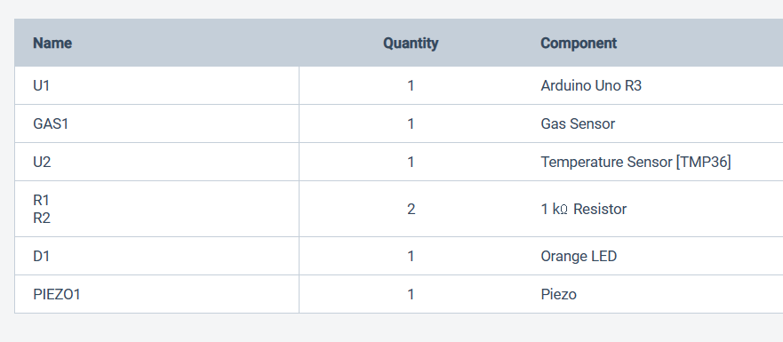
Required Components

Slide 5
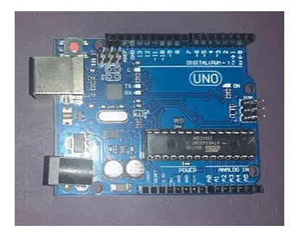
Required Components
1.Arduino UNO
Arduino board is a microcontroller that is used to accept inputs from sensors connected and provide an output action on the desired device connected to it. The sensor inputs can be from light-detecting sensors, motion sensors (Ultrasonic or IR), temperature sensors, etc. The output from this device can be received through other output devices such as LED, Buzzer, Serial monitor, etc.

Slide 6
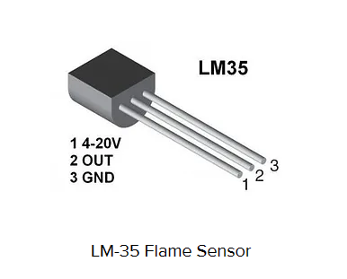
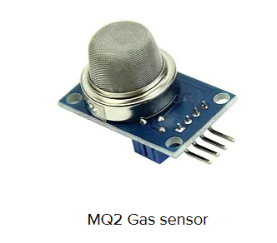
2. LM-35 Temperature Sensor
LM-35 Temperature Sensor gives an analog output based on the instantaneous
3.Gas Sensor
The gas sensor is used to measure the concentration or presence of gas in the atmosphere. It is also used to detect smoke in the air. Based on the gas, a potential difference is generated by changing the resistance of the material present inside the sensor. The output is measure in terms of Voltage.

Slide 7
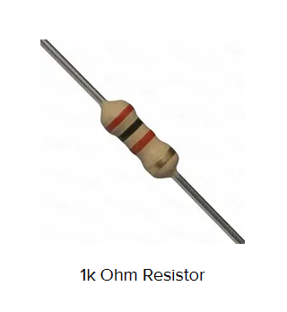
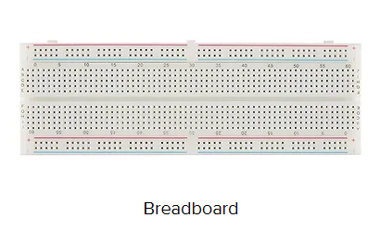
4.Resistors - 1k ohm
Resistors are passive devices that restrict the flow of current or divide the voltage through the circuit. The input power passes through these resistors and then to the sensors to avoid damage.
5.BreadBoard
The breadboard is the basic component of any circuit building process. All components, be it input sensors or output display devices are connected to the power supply, microcontroller using wired connections through a breadboard. The holes in the breadboard are in series. There are various sizes like full-sized, half-sized, and mini breadboard.

Slide 8
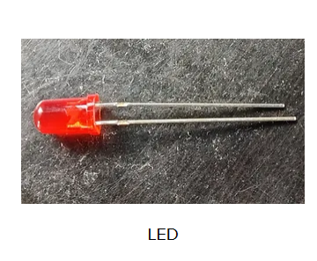
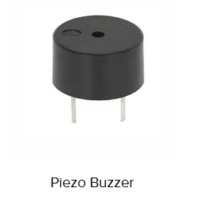
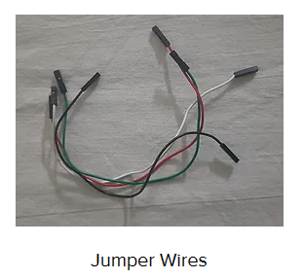
6.LED
Light Emitting Diode is a commonly used light source. It is a semiconductor that emits light when current flows through it.
7.Piezo Buzzer
It is an electrical component that generates a beep sound on receiving an input. It works on the principle of piezo crystal.
8.Jumper wires
Establish the connections between different devices of the circuit.

Slide 9
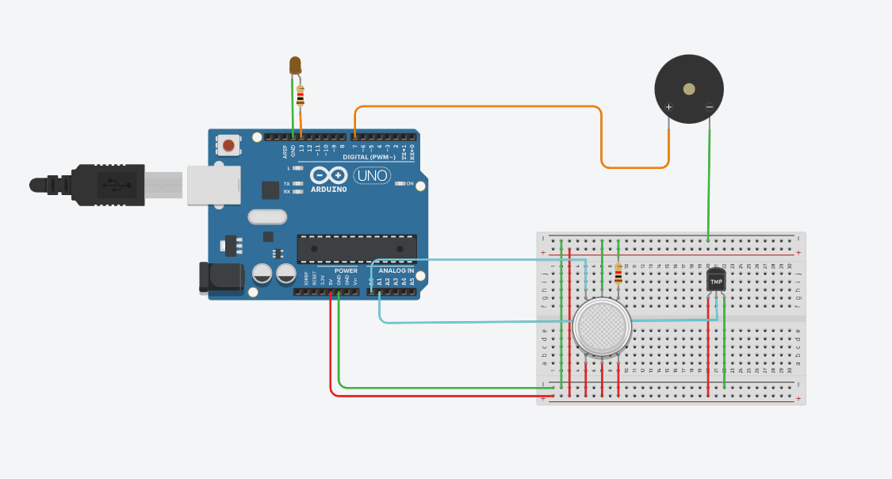
Circuit Connections

Slide 10
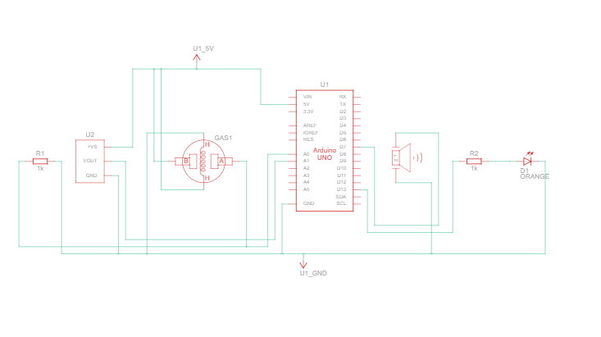
Circuit Connections- Schematic View

Slide 11
Working of Circuit
Part 1: Temperature sensor and its output.
The Temperature sensor takes in input and when the temperature increases, the voltage increases, and hence the output initiates the functioning of the Buzzer. For every one degree increase in temperature, there is a 10mV increase in the voltage.
Part2: Gas sensor and its output.
A gas sensor is also used to detect smoke along with the concentration of gases. Based on the type of gas present in the atmosphere, a potential difference is developed by changing the Resistance of the material present inside the sensor and the same is measured as output.

Slide 12
Thank you !!!
Team members :
1.Kavivarshini V - 20BIS018
2.Monika M - 20BIS025
3.Shanthini AJ - 20BIS040

